Slide 1

Chapter 3 : Principles Software Architecture
UTM KUALA LUMPUR

Slide 2
SOFTWARE ARCHITECTURE
The foundational software design activity that evaluates and translates software requirements (both functional and non-functional) into a collection of design elements that specify structural and behavioral aspects of the major components of the system.
Foundational Design
Requirement & Design Element
Design Quality & Construction
Software architecture provides the groundwork essential for meeting requirements.
This applies to both functional and non-functional requirements
Requirements is a tricky business! Inexperienced engineers tend not to see the many traps behind the requirements effort.
Avoid ambiguous requirements.
Architectural work focuses on the major components, the quality properties, and services.
Result in a design that supports efficient detailed design and construction.
2

Slide 3
KEY TASK IN ARCHITECTURAL DESIGN
01
STAKEHOLDERS CONCERN
04
MAJOR COMPONENTS AND INTERFACES
Stakeholders are persons, groups, or organizations that have a direct or indirect stake in the system.
Interfaces are defined for components residing within single physical nodes within a single or different process space, or for components residing on different physical nodes.
02
APPROPRIATE ARCHITECTURAL
05
EVALUATING, VALIDATING THE ARCHITECTURE
Different representations are required to evaluate certain properties of the system.
Long and iterative process. Failure to do so can have significant impact in effort and cost incurred.
03
INFLUENCES OF ARCHITECTURAL
07
DESIGN SYNCHRONICITY
Impact of Architectural Decisions in Organization.
Impact of Architectural Decisions in Quality Attributes.
Design synchronicity is a measurement of the degree of how well the software implementation reflects its design, both in architectural form and detailed design form.

Slide 4
QUALITY ATTRIBUTES, STAKEHOLDER CONCERNED
Tactics for Security
  Resisting Attacks
    Authenticating users, Limit exposure, Limit access, only on need-to-know basis , etc.
  Detecting Attacks
    Intrusion detection
Tactics for Testability
  Event logging
    Log data and operations throughout the system. Allow testers to enable/disable this feature so that when enabled, events are displayed in the console to give insight into the system’s operations and data.
Tactics for Modifiability
  Localize changes
    Modularization, abstraction, encapsulation
  Prevention of ripple effects
    Encapsulation, reduce coupling
Tactics for Availability
  Redundancy, Task monitor, Watchdog timer , etc.
Tactics for Performance
  Increase computation efficiency, reduce computational overhead, introduce concurrency, etc.
Quality | Description
Usability | The degree of complexity involved when learning or using the system.
Modifiability | The degree of complexity involved when changing the system to fit current or future needs.
Security | The system’s ability to protect and defend its information or information system.
Performance | The system’s capacity to accomplish useful work under time and resource constraints.
Reliability | The system’s failure rate.
Portability | The degree of complexity involved when adapting the system to other software or hardware environments.
Testability | The degree of complexity involved when verifying and validating the system’s required functions.
Availability | The system’s uptime.
Interoperability | The system’s ability to collaborate with other software or hardware systems.

Slide 5
PROBLEM SOLVING DURING ARCHITECURE
For example, we will reuse our home-grown class framework to leverage our expertise and develop faster!
Other project related constraints
Schedule Constraints,
Cost Constraints,
Quality Constraints
Another example, we will buy and integrate xyz library into our product instead of developing it ourselves
These define the problem and product constraints
Requirements,
System Goals,
Scenarios
Evaluate Constraints
Document
Architectural Designs,
Documentation
Interpret Problem
Collaborative Brainstorming
Evaluate
Architectural Design
Controls Examples:
1. Design reviews must be scheduled with one week of anticipation
2. Software Quality Assurance personnel must be present during review.
3. Review of material containing classified information must occur inside a vault
Unfortunately, these are rarely complete on the first shot!
Resources
Activities
Controls
Development team, modeling software, IDEs, hardware, etc.
Tasks performed to process the requirements
Example: Design Review
These dictate how, when, and where activities are performed!

Slide 6
SOFTWARE ARCHITECTURE PROCESS
01. Understand and Evaluate Requirement
Elicit technique using scenarios.
Requirement classification, prioritization and negotiation.
Specific and Valid.
05. Monitor and Control Implementation
Development and monitoring.
01
02
02. Design the Architecture
Architecture, design and tech stacks.
05
04. Document the Architecture
Upon completion all documented and signed of.
03
04
03. Evaluate the Architecture
Complete and matched.

Slide 7
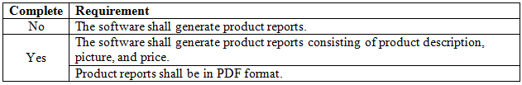


Examples
Notice how the original requirement is broken into two complete requirements!
This is a good requirement in the sense that it is specific and correct.
However, if we know the requirements for product reports, then a complete version of this requirement specifies this information. This help disambiguate the notion of a product report so that it can be implemented easily in code.
Can you meet this requirement today?

Slide 8
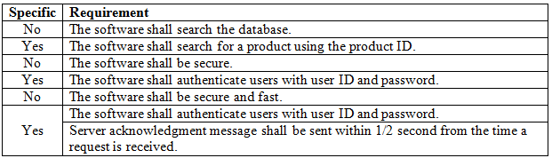

Examples
Search the database for what?
What does this mean?
Secure and fast?
These two requirements are specific and provide the information required to determine what secure and fast mean!
Register
Login Error!
Display error, per specification
Username:
Error: You must use a
unique combination of
user ID and password!
user123
Password:
pwd123
OK
user123 and pwd123 combination
is taken! What happens if I try to
log in using this combination?
Login
Attempt to register
Yes, that is right. The system has given away someone else’s logon information!

Slide 9
DESIGNING WITH THE 4 + 1 VIEW
01. LOGICAL VIEW
Component diagrams
Class diagrams
05. USER VIEW
Use cases and scenarios.
01
02
02. PROCESS VIEW
Sequence diagrams.
Communication diagrams.
05
04. PHYSICAL VIEW
Deployment diagrams.
Infrastructure diagrams.
03
04
03. DEVELOPMENT VIEW
Module or package diagrams.

Slide 10
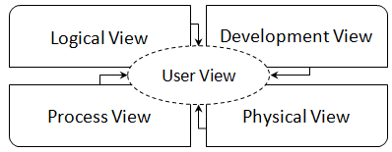
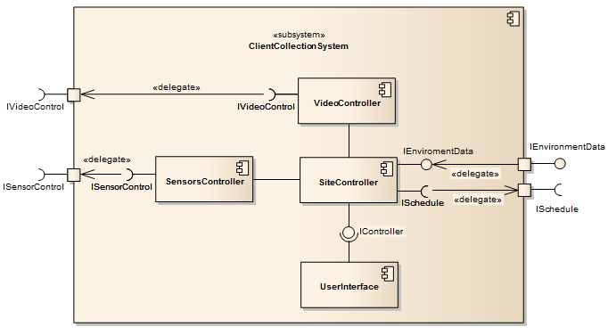
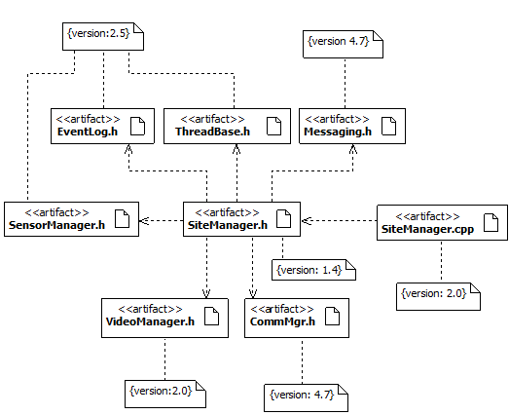
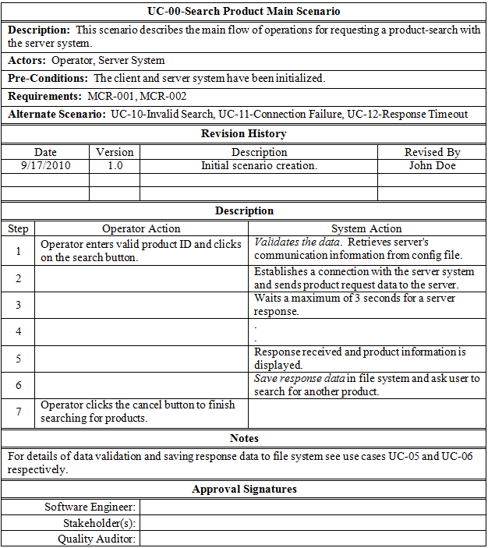
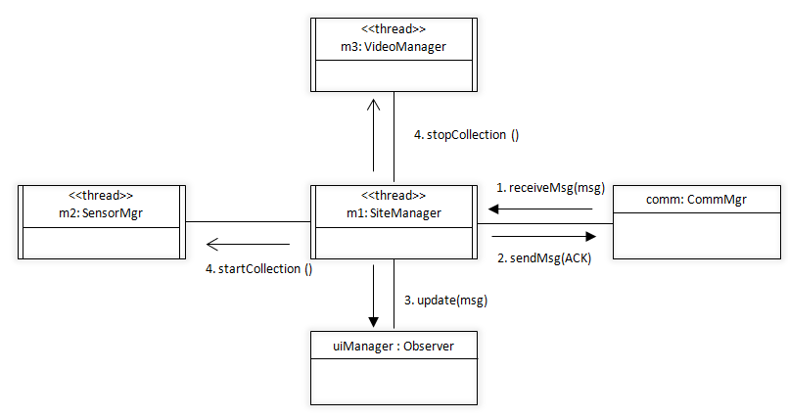
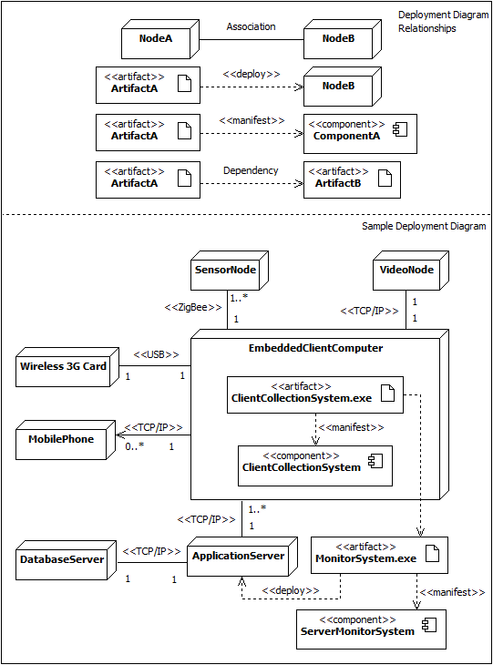
THE 4 + 1 VIEW
Logical View
Development View
User View
Process View
Physical View

Slide 11

Thank you for your participation. I am very grateful to have the opportunity into this sharing session. If there any enquiries, feels free to contact me.
+013 509 9215
khatibsyarbini@utm.my

Slide 12

THANK YOU
In the Name of God for Mankind
univteknologimalaysia
utm.my
utmofficial

